Slide 1

INSTITUTE OF ENGINEERING AND TECHNOLOGY,
LUCKNOW (UTTAR PRADESH)
PRESENTATION:
FULL STACK WEB JOB RECOMMENDATION SERVICE
SUBMITTED BY-
ANSHIKA YADAV (ROLL NO. 1805213012)
SANDEEP YADAV (ROLL NO. 1805213048)
UTKARSH GOEL (ROLL NO. 1805213061)
B-TECH 4th YEAR

Slide 2
What do we have for the presentation today?
Introduction
Abstract
Implementation Details
Features
Future Scopes
References

Slide 3
What is RozGAAR: A brief Introduction
There has been a high immigration rate since the global pandemic. This led to many of the daily wage workers losing their jobs. Now, this increases unemployability and gives a fair strong problem statement to use the growing era of technology in favour of these daily wage workers to get more and easily accessible employment.
Objectives were to provide easy access to a certain app or tool that can be used by major two section of society concerned with our problem statement, namely:
1. The daily wage workers
2. The recruiters/general public who seek to employ these workers
We have given them a single platform to connect and manage their needs. Whether it is getting a job or getting the job done. It has single OTP sign up and referral feature to appeal to users that have very limited access to the internet.

Slide 4
Abstract
RozGAAR is a common platform for daily-wage workers (like painters, gardeners etc) and their recruiters to connect in order to increase their employability during global pandemic crises.
It has an easy to understand one click login system where the daily wage workers need not to remember their username or password. Be a worker or a recruiter, we got you covered.
As Worker, You can
Create your profile with your job preferences.
Find the perfect job that you require from the job posted by our registered recruiters.
Filter your jobs according to your preferences and contact the recruiter.
Refer other workers who do not have proper internet connection.
As Recruiter, You can
Look for the worker you need from your dashboard.
Create job openings on which a worker can contact you.
Filter worker profiles according to your needs.

Slide 5
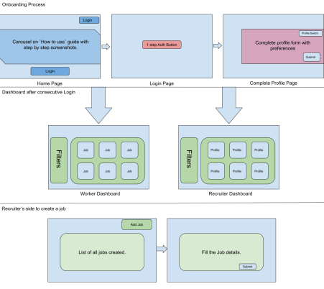
Implementation Details: High level Flows [Initial Draft]

Slide 6
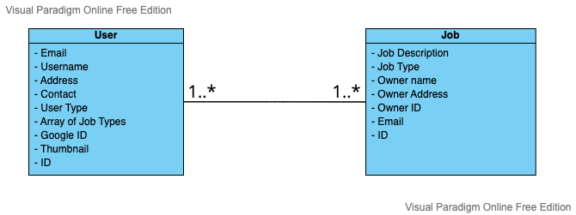
Implementation Details: Class Diagram
Class Diagram of Entities used

Slide 7
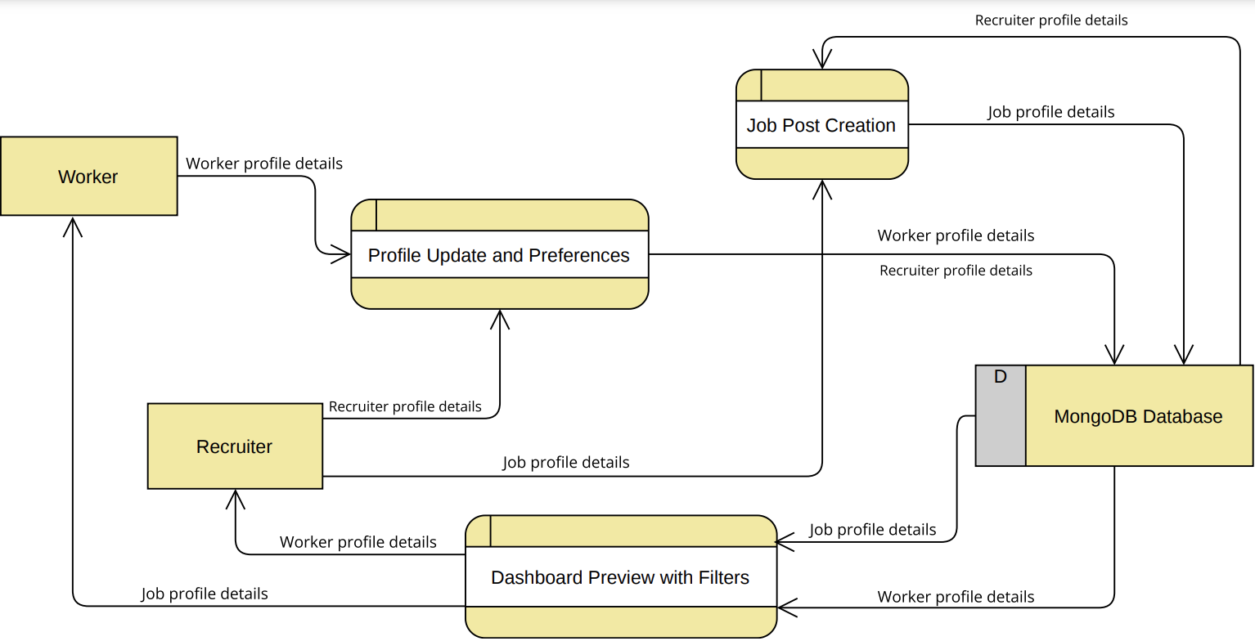
Implementation Details: Data Flow Diagram
Level 2 Data Flow Diagram

Slide 8
Let’s look at our features in action
Included features are:
Easy to understand interface and home page with a video for workers to understand how to use the website
Login using Mobile number with simple OTP verification
Google authorization login system for both workers and recruiters
Job posting service for recruiters who can contact a worker to hire him/ her directly as well,
Choice-based dashboard to display jobs and profiles with dynamic data update,
Filter options according to preferences etc.
Workers can refer other worker profiles, so that even if the other worker is unable to get the internet access, they can get the updates via push messages

Slide 9
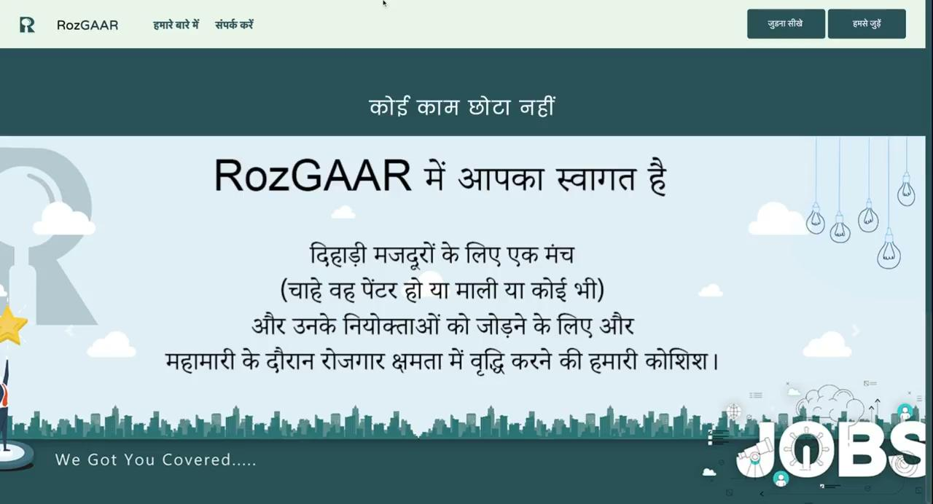
Simple Interface and Home Page

Slide 10
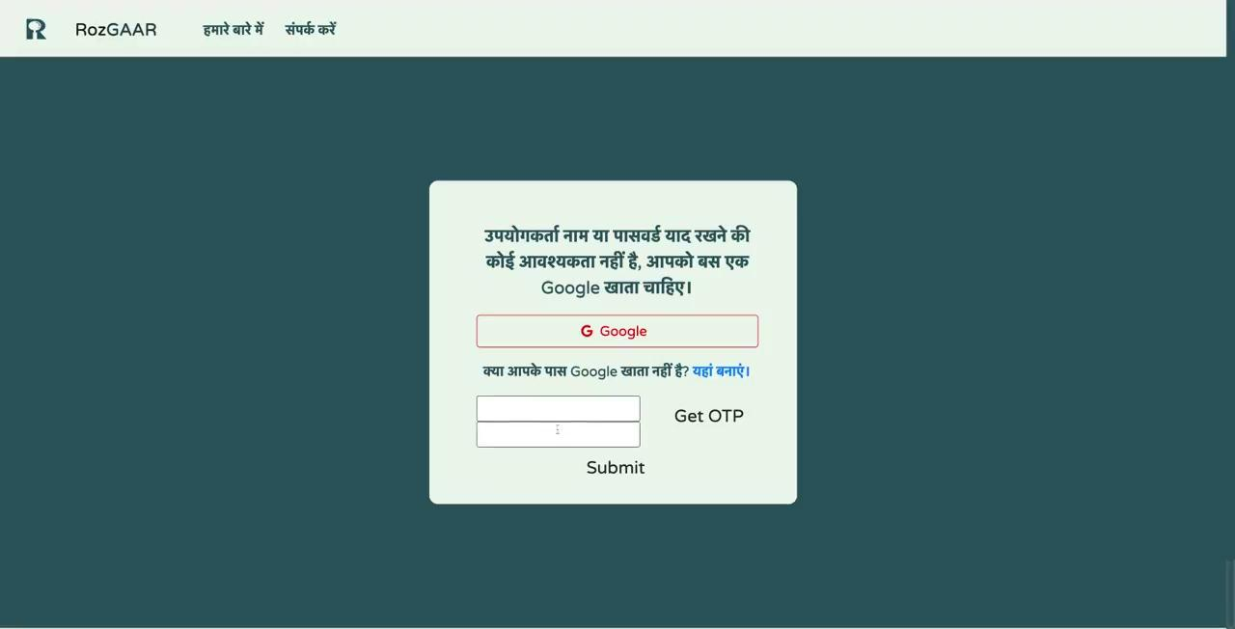
OTP Login

Slide 11
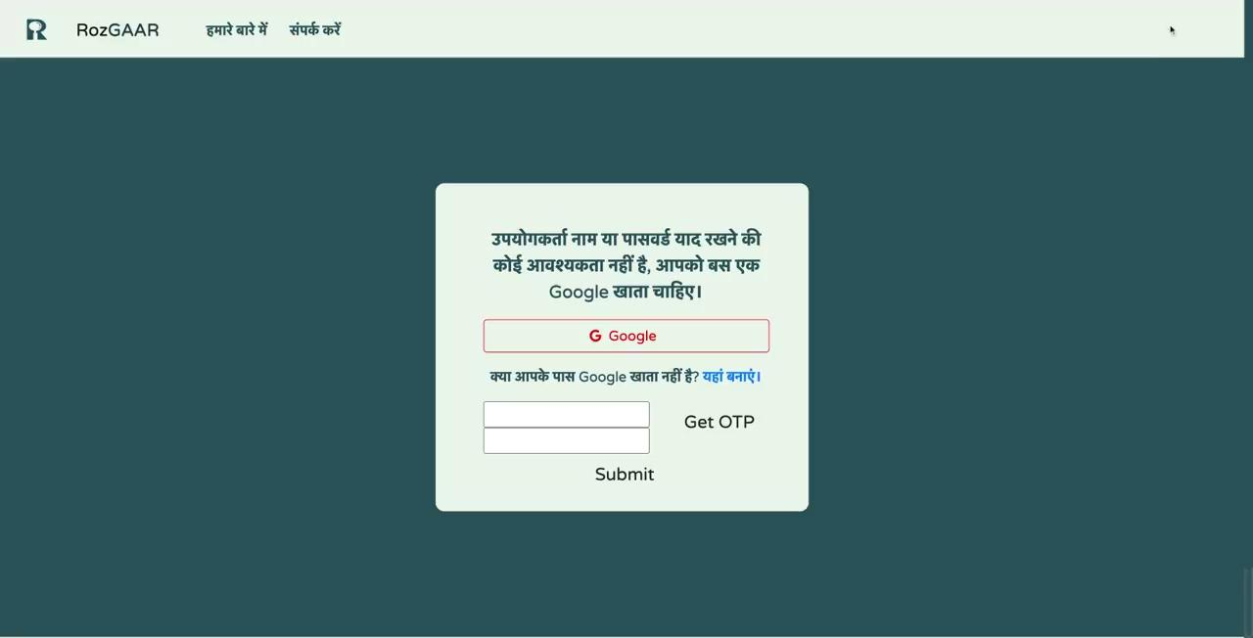
One click Google login

Slide 12
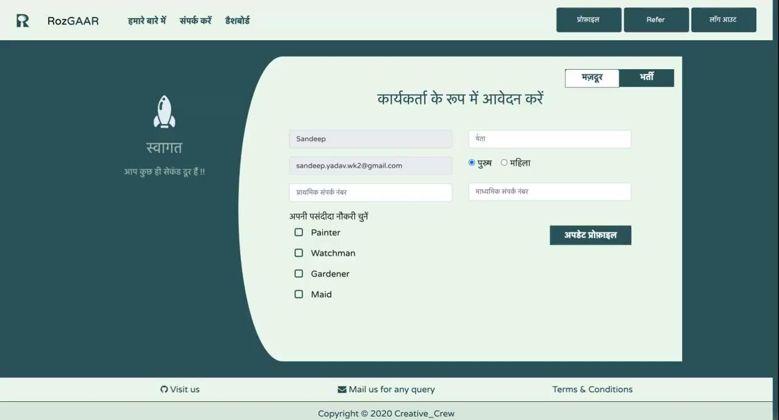
As Worker: Profile type selection and preferences

Slide 13
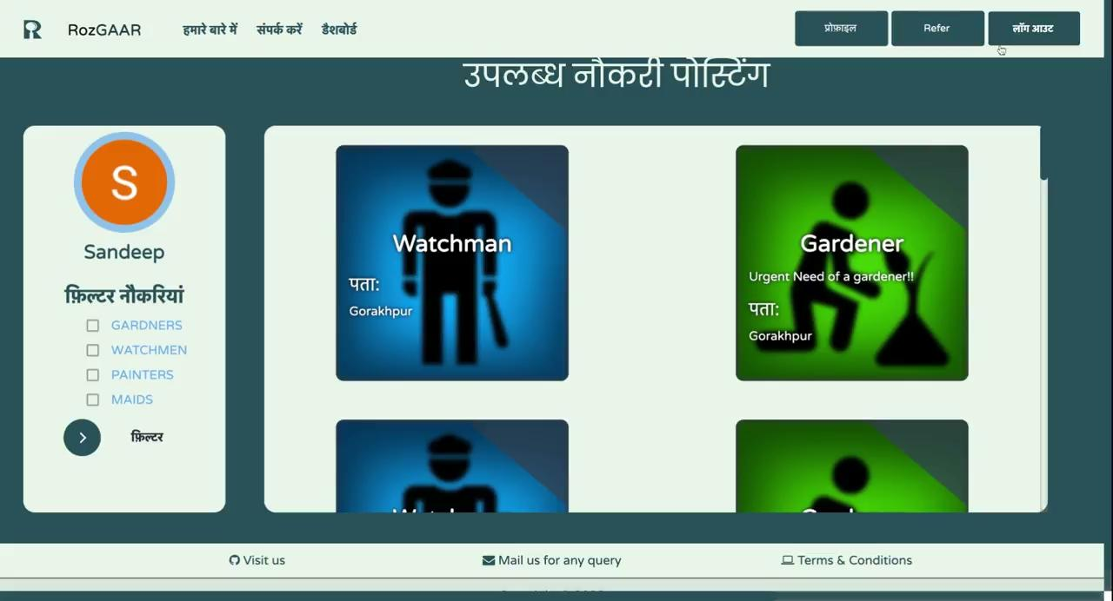
As Worker: Job profile Dashboard with relevant jobs

Slide 14
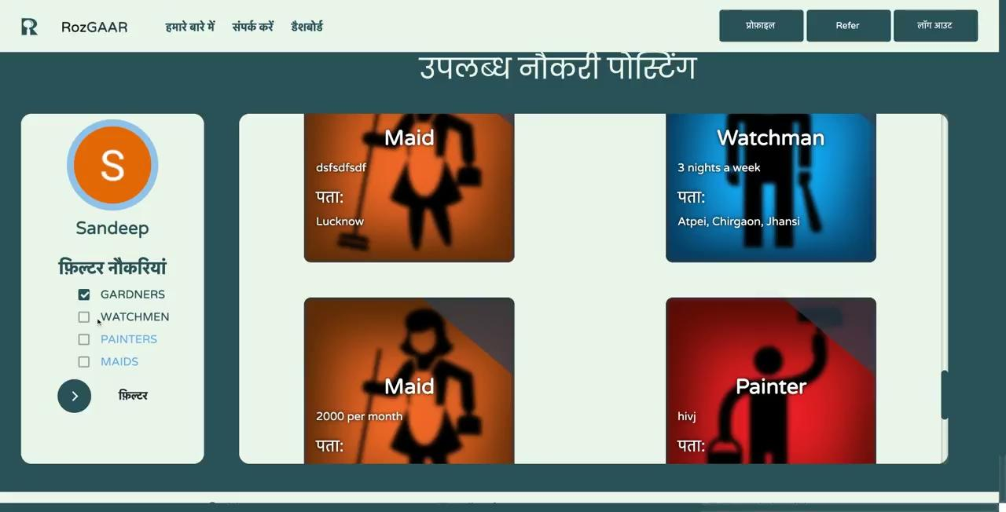
As Worker: Filter Jobs as required

Slide 15
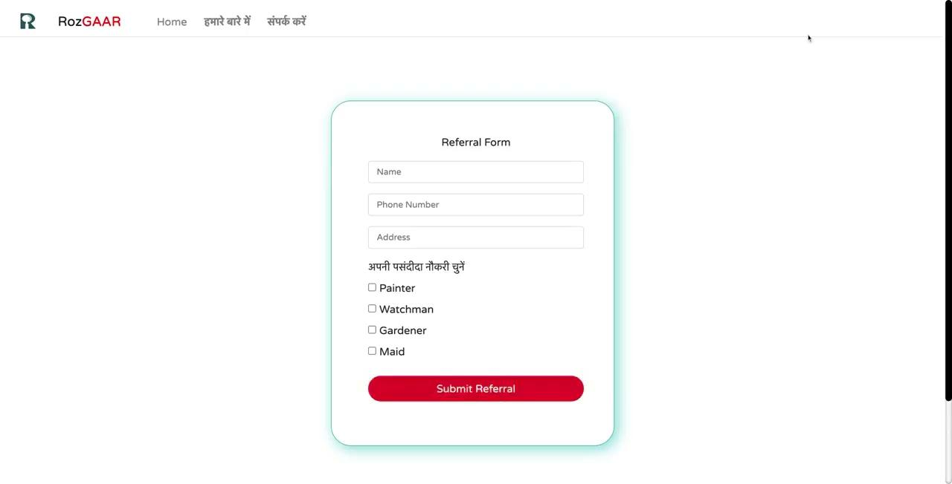
As Worker: Refer other workers

Slide 16
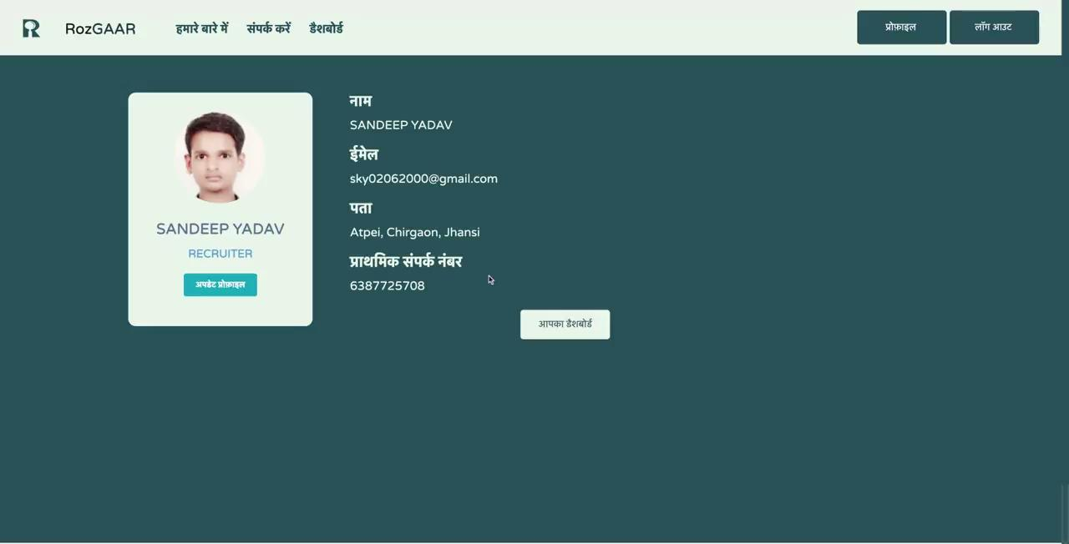
As Recruiter: Profile type selection and details

Slide 17
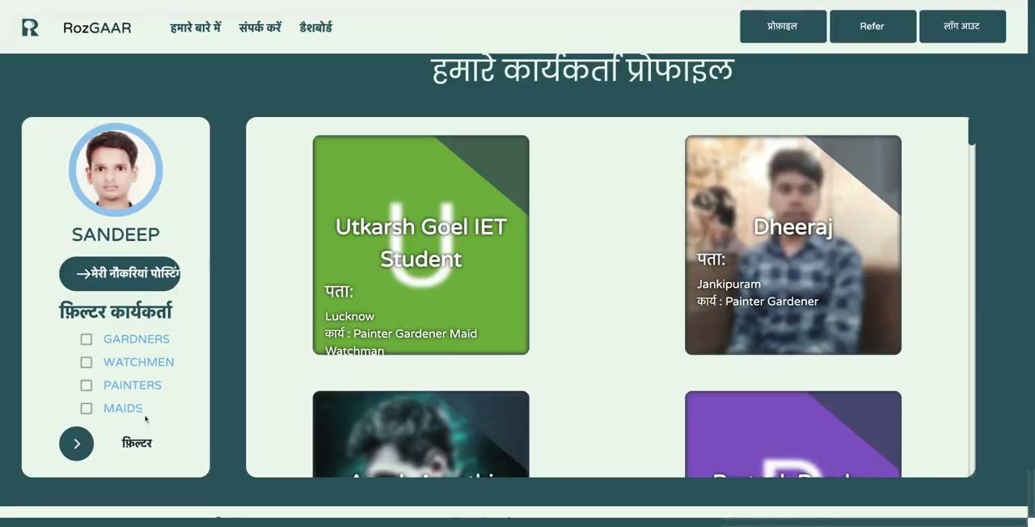
As Recruiter: Worker Profiles Dashboard

Slide 18
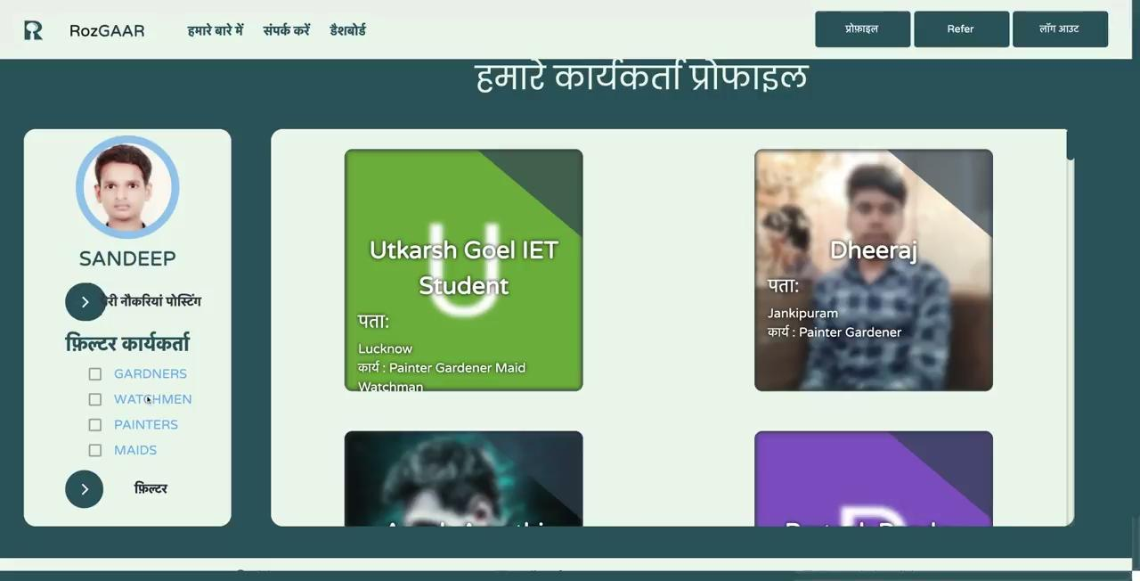
As Recruiter: Filter profiles as required

Slide 19
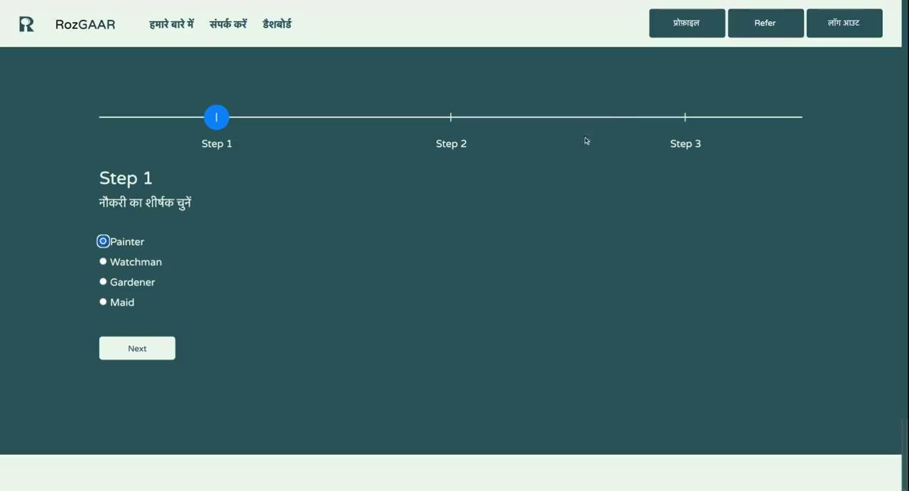
As Recruiter: Job posting feature to post new jobs of different types

Slide 20
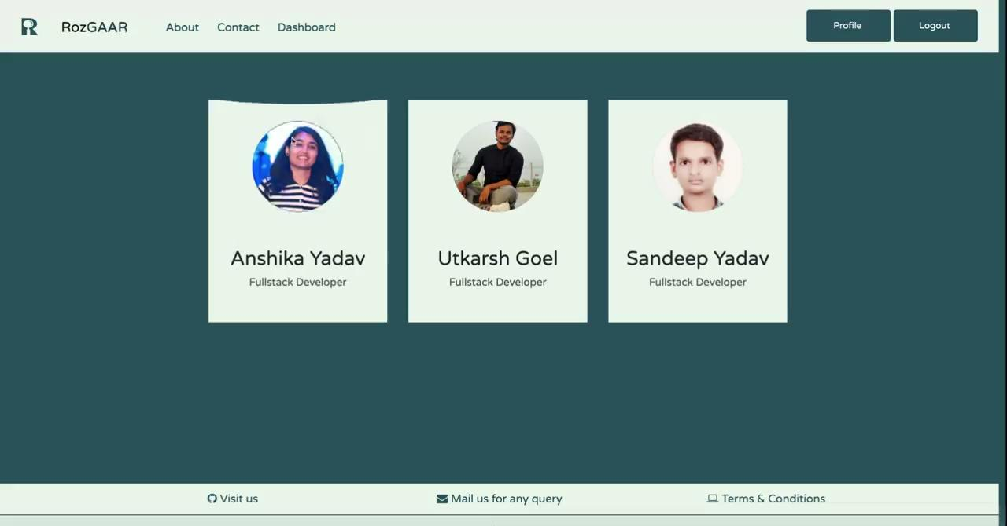
About Us page

Slide 21
What can we add in the future?
Push Notifications: Send push notifications and messages to registered mobile number of the worker to make it easy for him to connect to recruiter
Adding biometrics: Fingerprints or any kind of biometrics can be implemented to sign up with the website
Adding more job profiles: Inclusion of a broad range of job profiles and fields of work
Adding chat services: Incorporating a tool to communicate for the recruiters and candidates directly over the application.
Adding payment services: Making subscription options available to both recruiters and job-seekers.
Have a KNN set up: Calculate distance using google map APIs between the worker and jobs(recruiters) and then suggesting job and worker profiles relatively.
Filter entity: Showing job profiles and worker profiles based on recent filters.

Slide 22
References
https://www.forbes.com/sites/jackkelly/2021/07/12/the-great-jobs-mismatch-why-companies-arent-hiring-and-candidates-cant-find-jobs/?sh=1ccfacd6276c
https://www.microsave.net/2021/05/28/how-did-covid-19-affect-the-incomes-of-migrants-and-low-wage-workers-in-india/
https://scroll.in/article/989258/how-daily-wage-workers-in-india-suffered-in-the-lockdown-and-continue-to-struggle-months-later
https://www.bbntimes.com/companies/understanding-the-communication-gap-between-recruiters-and-candidates

Slide 23
Thank you!

